Slide 1
Modeling but NOT Measuring Engagement in Computer Games
Mark Chen
with Beth Kolko, Elisabeth Cuddihy, Eliana Medina
@mcdanger | markchen@uw.edu
markdangerchen.net

Slide 2
Notes:
Malone & Lepper
Heeter
Lazarro
Flow

Slide 3
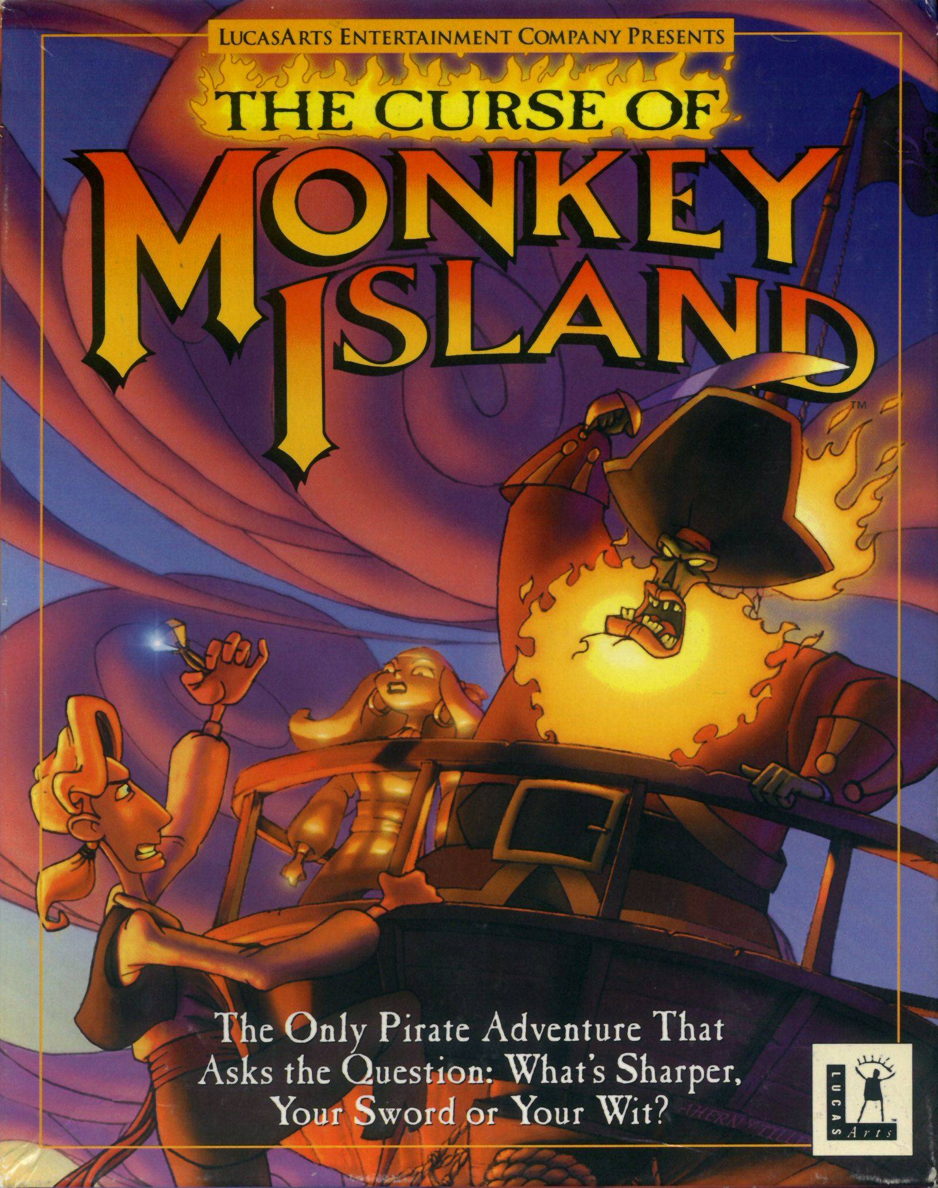
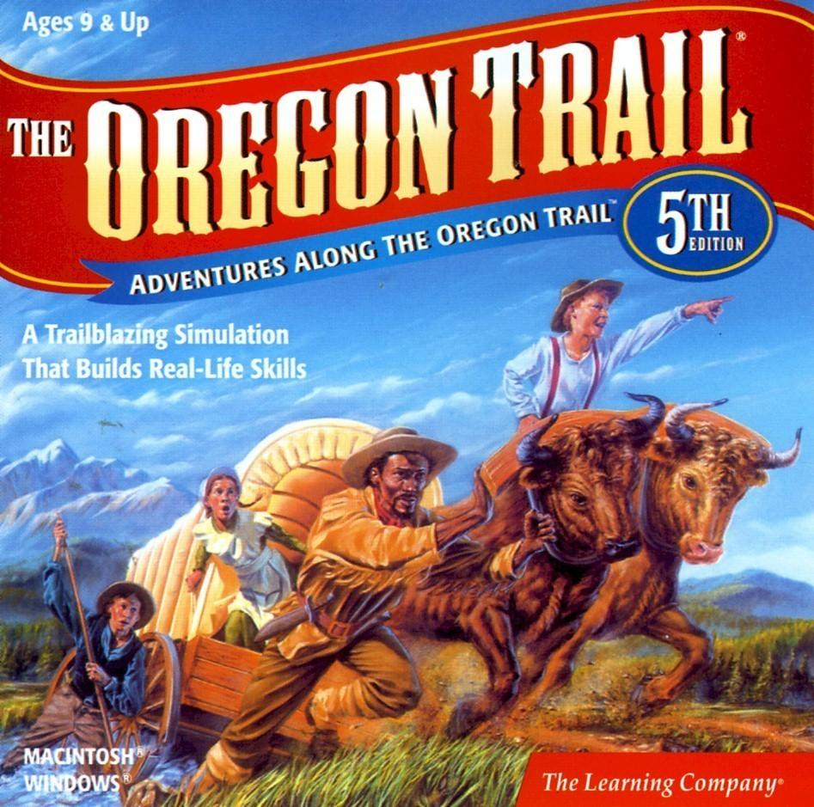
Methods
Compare two games:
The Curse of Monkey Island
89.9% metascore on gamerankings.com
The Oregon Trail 5th Edition
assumed worse than a successful commercial game

Slide 4
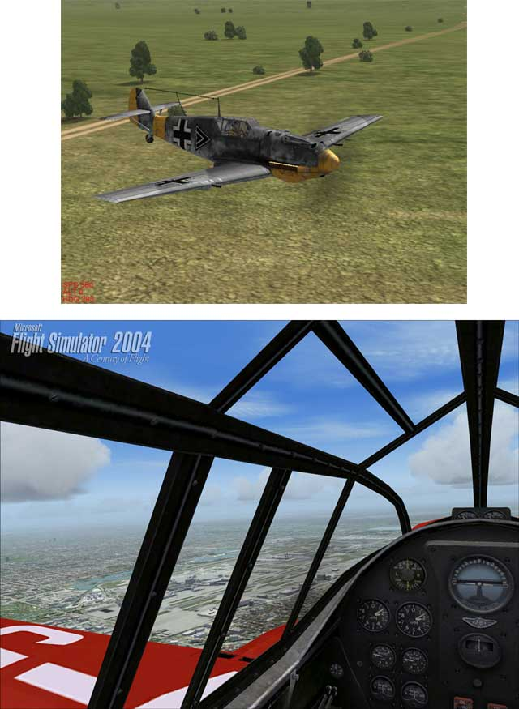
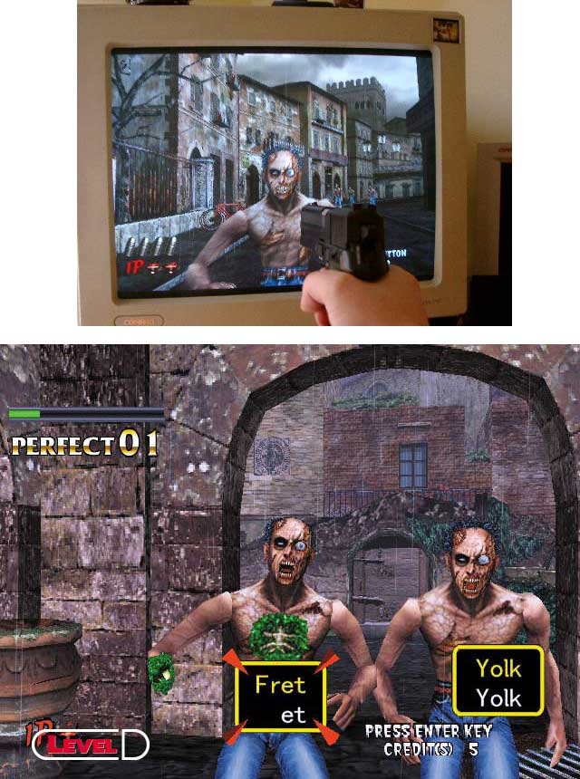

Slide 5
Methods
Lab studies
Immersive Tendencies Questionnaire
e.g., Do you ever become so involved in doing something that you lose all track of time?
Gaming Engagement Questionnaire
e.g.,Were you involved in the game to the extent that you lost track of time?
(based on Witmer & Singer, 1998, Presence Questionnaire)
observation
during-game flow questions (Csikszentmihalyi, 1990)
post-game interviews

Slide 6
Big Heap o’ Fail
Adrian Bruce http://adrianbruce.com/teacher-toolbox/the-fail-whale/

Slide 7
Big Heap o’ Fail
The Oregon Trail >The Curse of Monkey Island !!
Curse’s score didn’t reflect metascore
Pilot test participants were frustrated with Curse much more so than with The Oregon Trail

Slide 8
What happened?
Wrong assumptions:
metascore from game reviews = engagement
reviews done after hours of play
reviewers have deep knowledge of gaming culture and game genres
educational titles must be worse than commercial titles
didn’t select The Oregon Trail based on metascore
testing methods over emphasize immersion and usability
We were noobs.

Slide 9
(de)motivation
conference win, paper fail (guilt/shame)
presented at DiGRA, but not a full paper
never completed study or full paper
group parted ways (re: noobness)

Slide 10
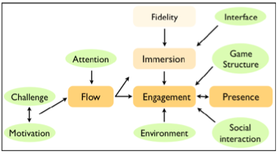
It’s still useful!
not that bad; our model is still useful and relevant, our questionnaires still useful
(Bianchi-Berthouze, Kim, & Patel, 2007)

Slide 11
What now?
Hall of Fail as win-win!
need to include ecologically valid methods to studying engagement
capture affective aspects of engagement

Slide 12
Modeling but NOT Measuring Engagement in Computer Games
Mark Chen
with Beth Kolko, Elisabeth Cuddihy, Eliana Medina
@mcdanger | markchen@uw.edu
markdangerchen.net

